Slide 1


Propential
FOR ACCREDITED BROKERS
Refer in minutes. Settle in days.
A property-secured improvement loan, and $495 in your pocket per settlement.
PROPENTIAL · BROKER PARTNERSHIP
CONFIDENTIAL

Slide 2
THE OPPORTUNITY
Your clients own the asset. They just can't unlock it cleanly.
REFINANCING
UNSECURED LOANS
PROPENTIAL
Slow, costly and disturbs a home loan they're happy with.
Small limits and high rates for the size of project they have in mind.
A property-secured improvement loan that sits exactly in the gap.
PROPENTIAL · BROKER PARTNERSHIP
02

Slide 3
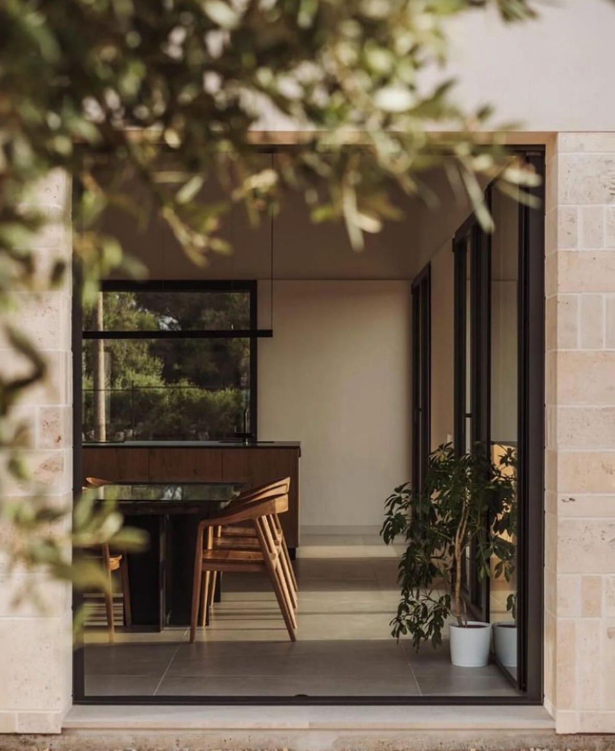
MEET PROPENTIAL
One clear product, secured by the home they already own.
Propential is a fixed-term loan secured against a property your client owns, taken by caveat or second mortgage (NT and QLD only). They borrow a set amount, repay it with principal & interest, and put it toward improving the place they live.
PROPENTIAL · BROKER PARTNERSHIP
03

Slide 4
THE PRODUCT AT A GLANCE
Simple to explain. Easy to recommend.
LOAN SIZE
ONE CLEAR RATE
TERM
REPAYMENTS
SECURITY
$5k–$175k
17.95%
1–10
Fortnightly
Caveat or
p.a.
yrs
or monthly
2nd mortgage
Secured, fixed-term.
The same rate for everyone.
Up to 7 yrs ≤$50k; up to 10 yrs above.
Principal & interest.
Existing home loan untouched.
With no early payment fees.
(NT & QLD)
Comparison rate 21.3% p.a., based on a $30,000 5-year secured loan.
PROPENTIAL · BROKER PARTNERSHIP
04

Slide 5

WHAT IT FUNDS
Any project that improves the property and adds value.
INTERIORS
KITCHENS & BATHS
POOLS
FENCING
LANDSCAPING
ROOFING
It's a fixed-term, secured loan, not a line of credit and not for construction.
PROPENTIAL · BROKER PARTNERSHIP
05

Slide 6




WHY YOUR CLIENTS SAY YES
Four reasons it's an easy yes.
Their home loan stays put
One clear rate
A real end date
Quick to settle
Sits behind their existing mortgage, with no refinance and no disturbance.
17.95% p.a. for everyone, with no risk-based surprises to explain.
Fixed term with principal & interest, so it's paid off, not perpetual.
An eligibility check with no credit-file impact, then a fast assessment.
PROPENTIAL · BROKER PARTNERSHIP
06

Slide 7
A fee worth referring for.
YOUR COMMISSION
$495
Once-off
A flat fee per settled loan, with nothing tiered to track.
No claw-back
Once it's settled, it's yours, even if the loan is later repaid or refinanced.
per settlement
Paid after settlement
No waiting on milestones; paid once the loan settles.
PROPENTIAL · BROKER PARTNERSHIP
07

Slide 8
HOW REFERRING WORKS
Four steps. You stay in the loop.
01
02
03
04
Refer your client
They check eligibility
We assess & settle
You're paid $495
Send them to Propential with your referral code; that's what ties the deal to you.
An instant eligibility check with no impact on their credit file.
We handle the application, valuation, responsible-lending checks and settlement.
Your commission is paid once the loan settles. No claw-back.
PROPENTIAL · BROKER PARTNERSHIP
08

Slide 9
BUILT ON SOLID GROUND
A licensed lender your name is safe beside.
LENDER
AUSTRALIAN CREDIT LICENCE
RESPONSIBLE LENDING
CUSTOMER CARE
MediPay Holdings Pty Limited
474336
Assessed every time
Hardship & complaints
The licensed credit provider behind Propential.
Lending under the National Credit Code.
Suitability and capacity to repay on every application.
Clear processes, plus a published Target Market Determination.
PROPENTIAL · BROKER PARTNERSHIP
09

Slide 10


WHY PARTNER WITH PROPENTIAL
A clean product and a fee worth referring for.
$495 per settlement, no claw-back
Simple to refer; we do the heavy lifting
A premium brand that reflects well on you
A product your clients actually want
PROPENTIAL · BROKER PARTNERSHIP
10

Slide 11

BECOME AN ACCREDITED PROPENTIAL BROKER
Let's get you set up to refer.
Accreditation takes minutes. Your first $495 could be a settlement away.
EMAIL
PHONE
partners@propential.com.au
1800 012 795
We reply within one business day.
Get accredited →
PROPENTIAL · MEDIPAY HOLDINGS PTY LIMITED · ACL 474336
11

